Slide 1
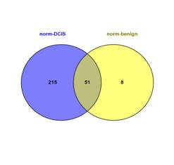
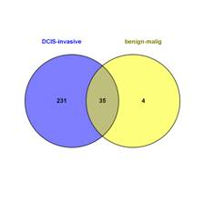
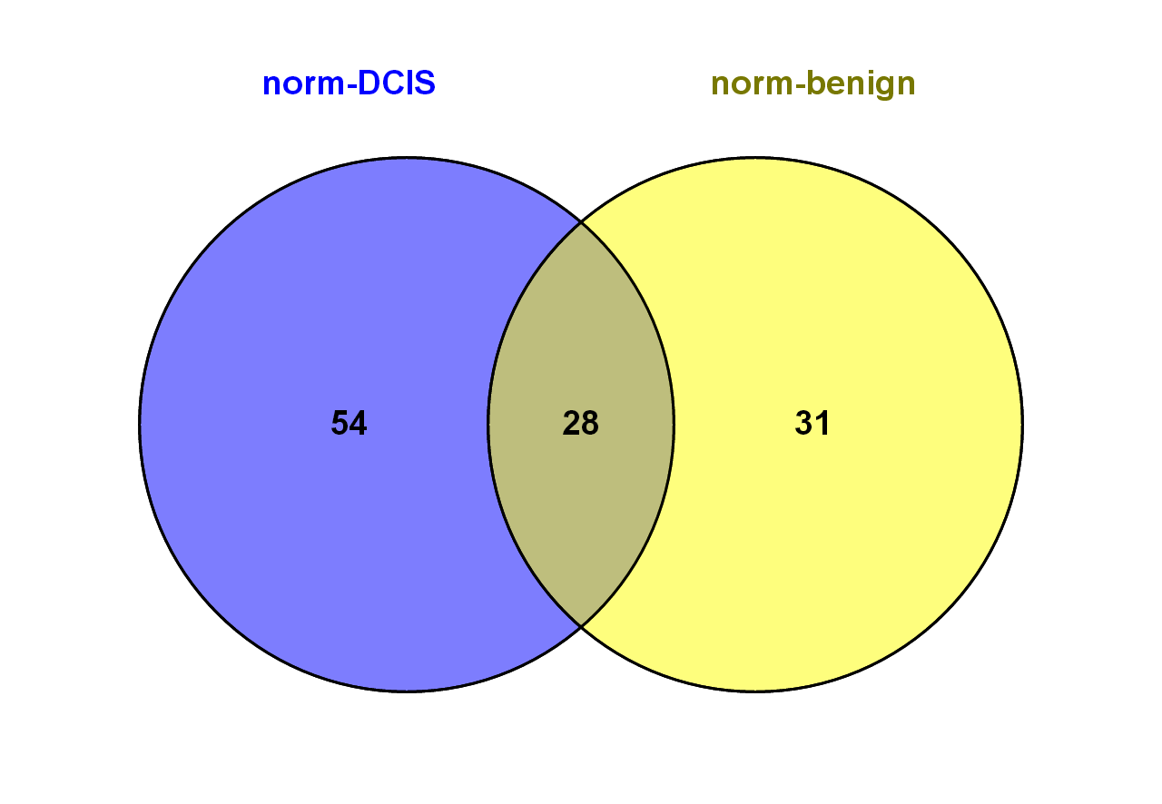
A
B
C
Supplementary Figure S2. Comparison of miRNAs differentially expressed in this study and Tahiri et al, 2014 A) and B) miRNAs differentially expressed in Tahiri et al, 2014. C) miRNAs differentially expressed in the current study (blue) and in Tahiri et al (yellow)

